Slide 1
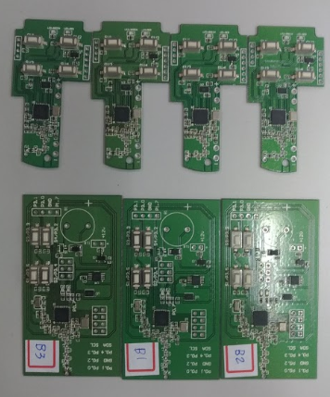
Remote Control
How to program Crypto & MCU

Slide 2
Tasks
When FOB and Host board are ready
There are two tasks to make this demo work
First one is crypto configuration, you need to config IC ATSHA204 with you Product key
2nd is to program MCU internal code flash

Slide 3
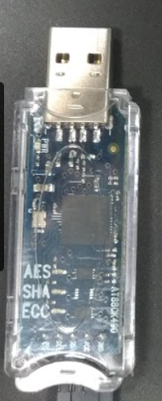
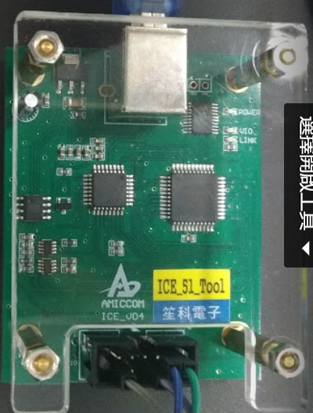
Programming Tools
To config Crypto ATSHA204, you need
HW: AT88CK490/ AT88CK590
(you can buy directly from Digikey)
SW: ATMEL ACES Tool
http://ww1.microchip.com/downloads/en/DeviceDoc/AcesSetup-6.0.3.exe
Amiccom A9112
HW: AMICCOM ICE_V04
(sales@amiccom.com.tw)
SW: Keil-C

Slide 4
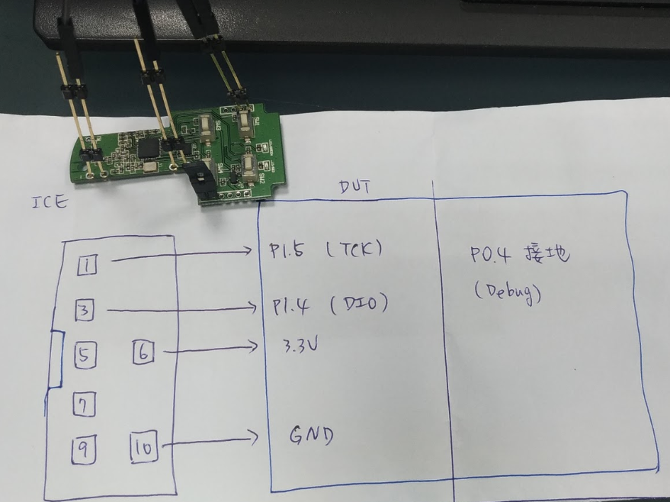
Program A9112
Amiccom ICE
Wire as right picture
P0.4 must to GND before board power on
Notes:
Layout (NOT yet)

Slide 5
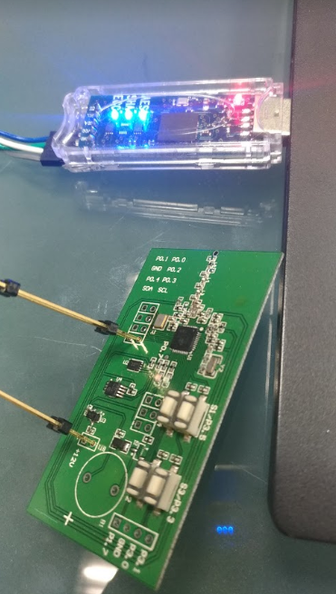
Program Cyrpto ATSHA204
You need to remove ATSHA204 IC on AT88CK490 EVB, it will confuse with ATSHA204 on remote control board
Wire AT88CK490 VCC, GND, SCL, SDA to FOB or Host boards
Open ACES tool
If you see the ATSHA204 blue light is on, that mean tool detect the ATSHA204 IC on FOB or Host board
Notes:
Layout (NOT yet)

Slide 6
Video
There are 4 Introduce video
Program Crypto IC ATSHA204 and MCU A9112 part 1
https://www.youtube.com/watch?v=5jzsl8CL4TQ
Program Crypto IC ATSHA204 part 2
https://www.youtube.com/watch?v=W8XiA6IgFrc
Program MCU A9112 (FOB) part 3
https://www.youtube.com/watch?v=bPXdFuQagkY
Program MCU A9112 internal flash. Host side. Part 4
https://www.youtube.com/watch?v=WnwUjpWubKQ
Notes:
Layout (NOT yet)

Slide 7
Good Luck !!
Notes:
Layout (NOT yet)

